Slide 1
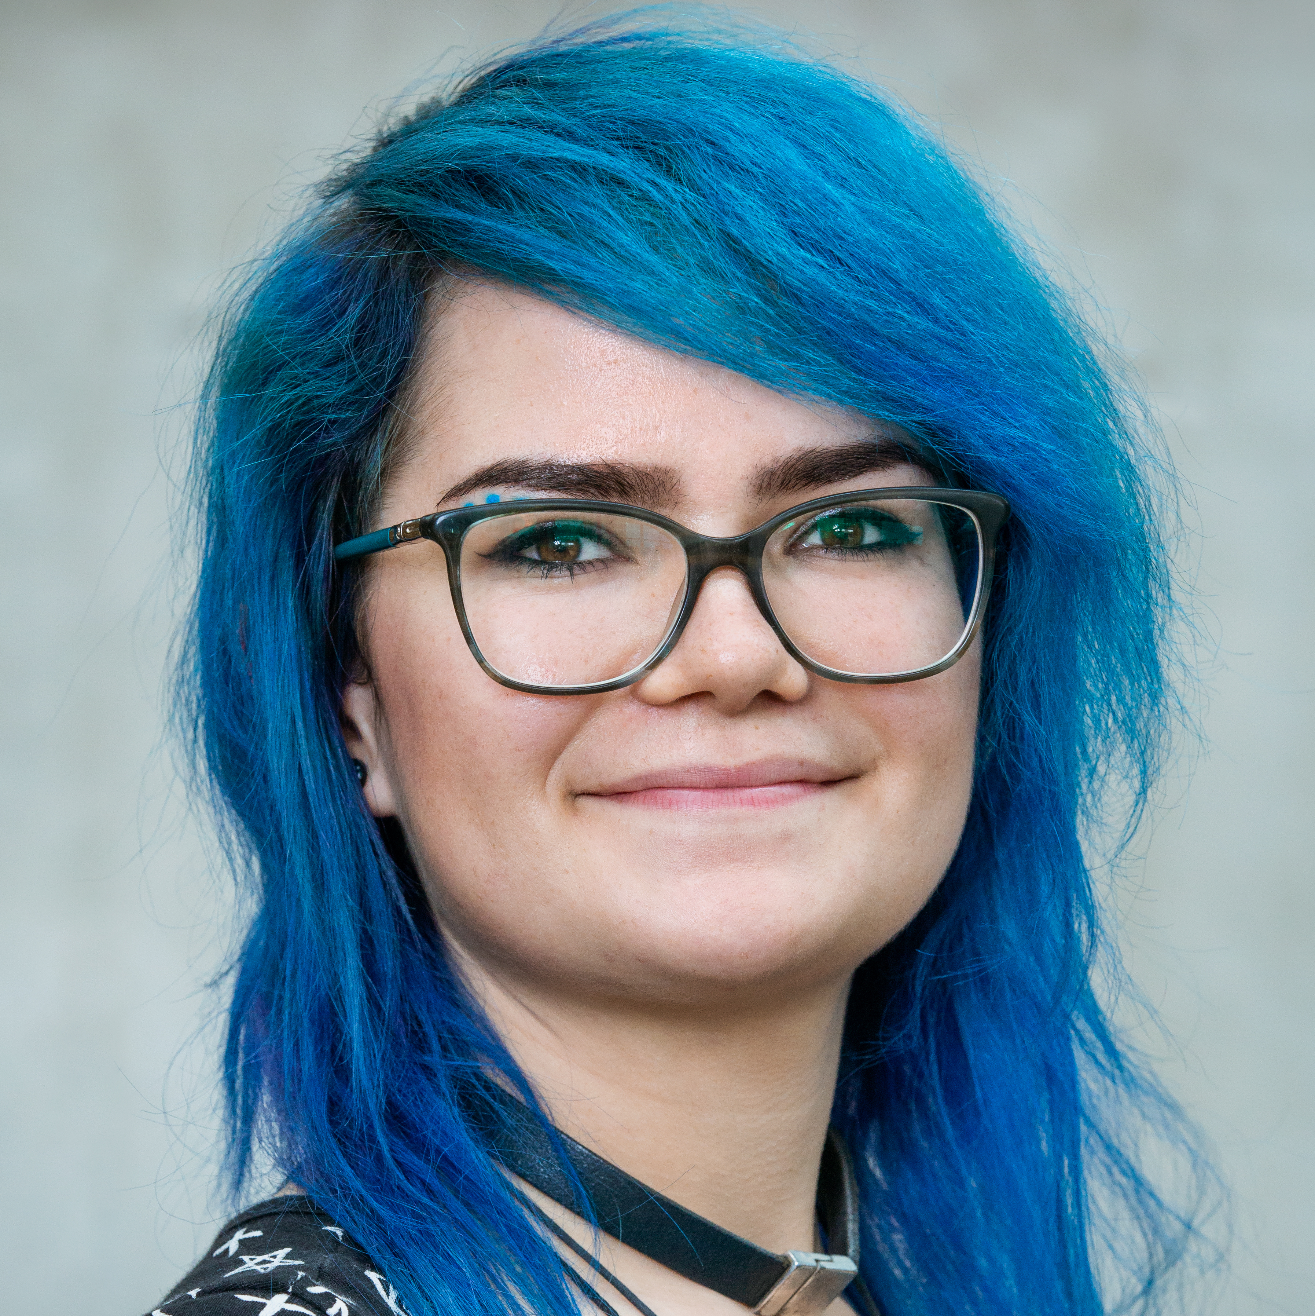
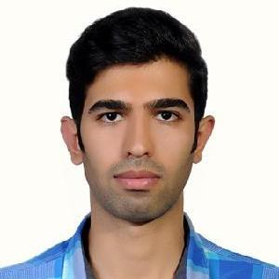
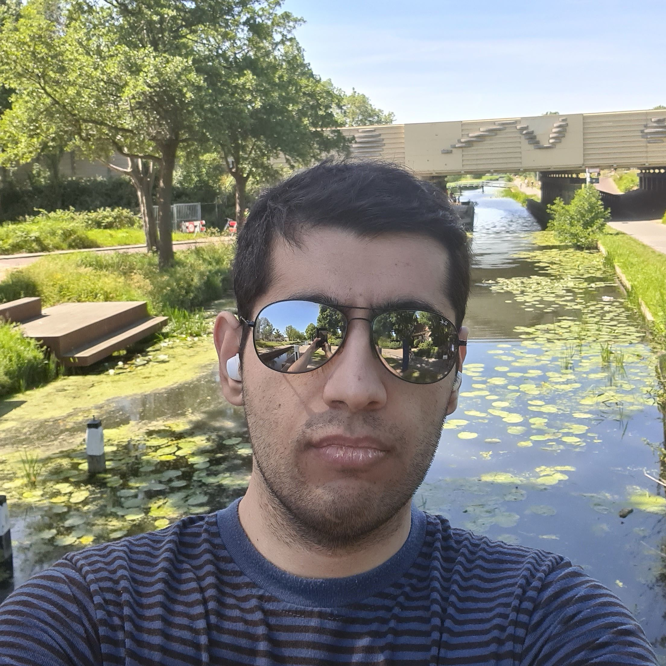
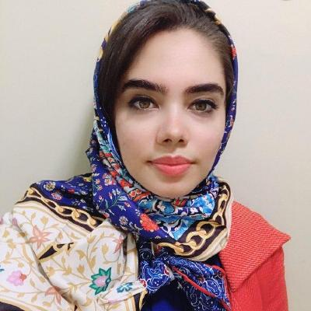
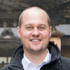
This livestreaming session brought to you by:
Silvia Abrahão
Zoomer
Claudia Ayala
Zoomer
Carolin Brandt
OBS Streamer
Oscar Dieste
Zoomer
Rodrigo Fonseca
Zoomer
Mehdi Keshani
OBS Streamer
Marc Oriol
Zoomer
Ignacio Panach
Zoomer
Amir Mir
OBS Streamer
Pilar Rodríguez
Zoomer
Sergio Segura
Zoomer
Maliheh Izadi
OBS Streamer
Martín Solari
Zoomer
Sebastian Proksch
OBS Streamer

